Slide 1
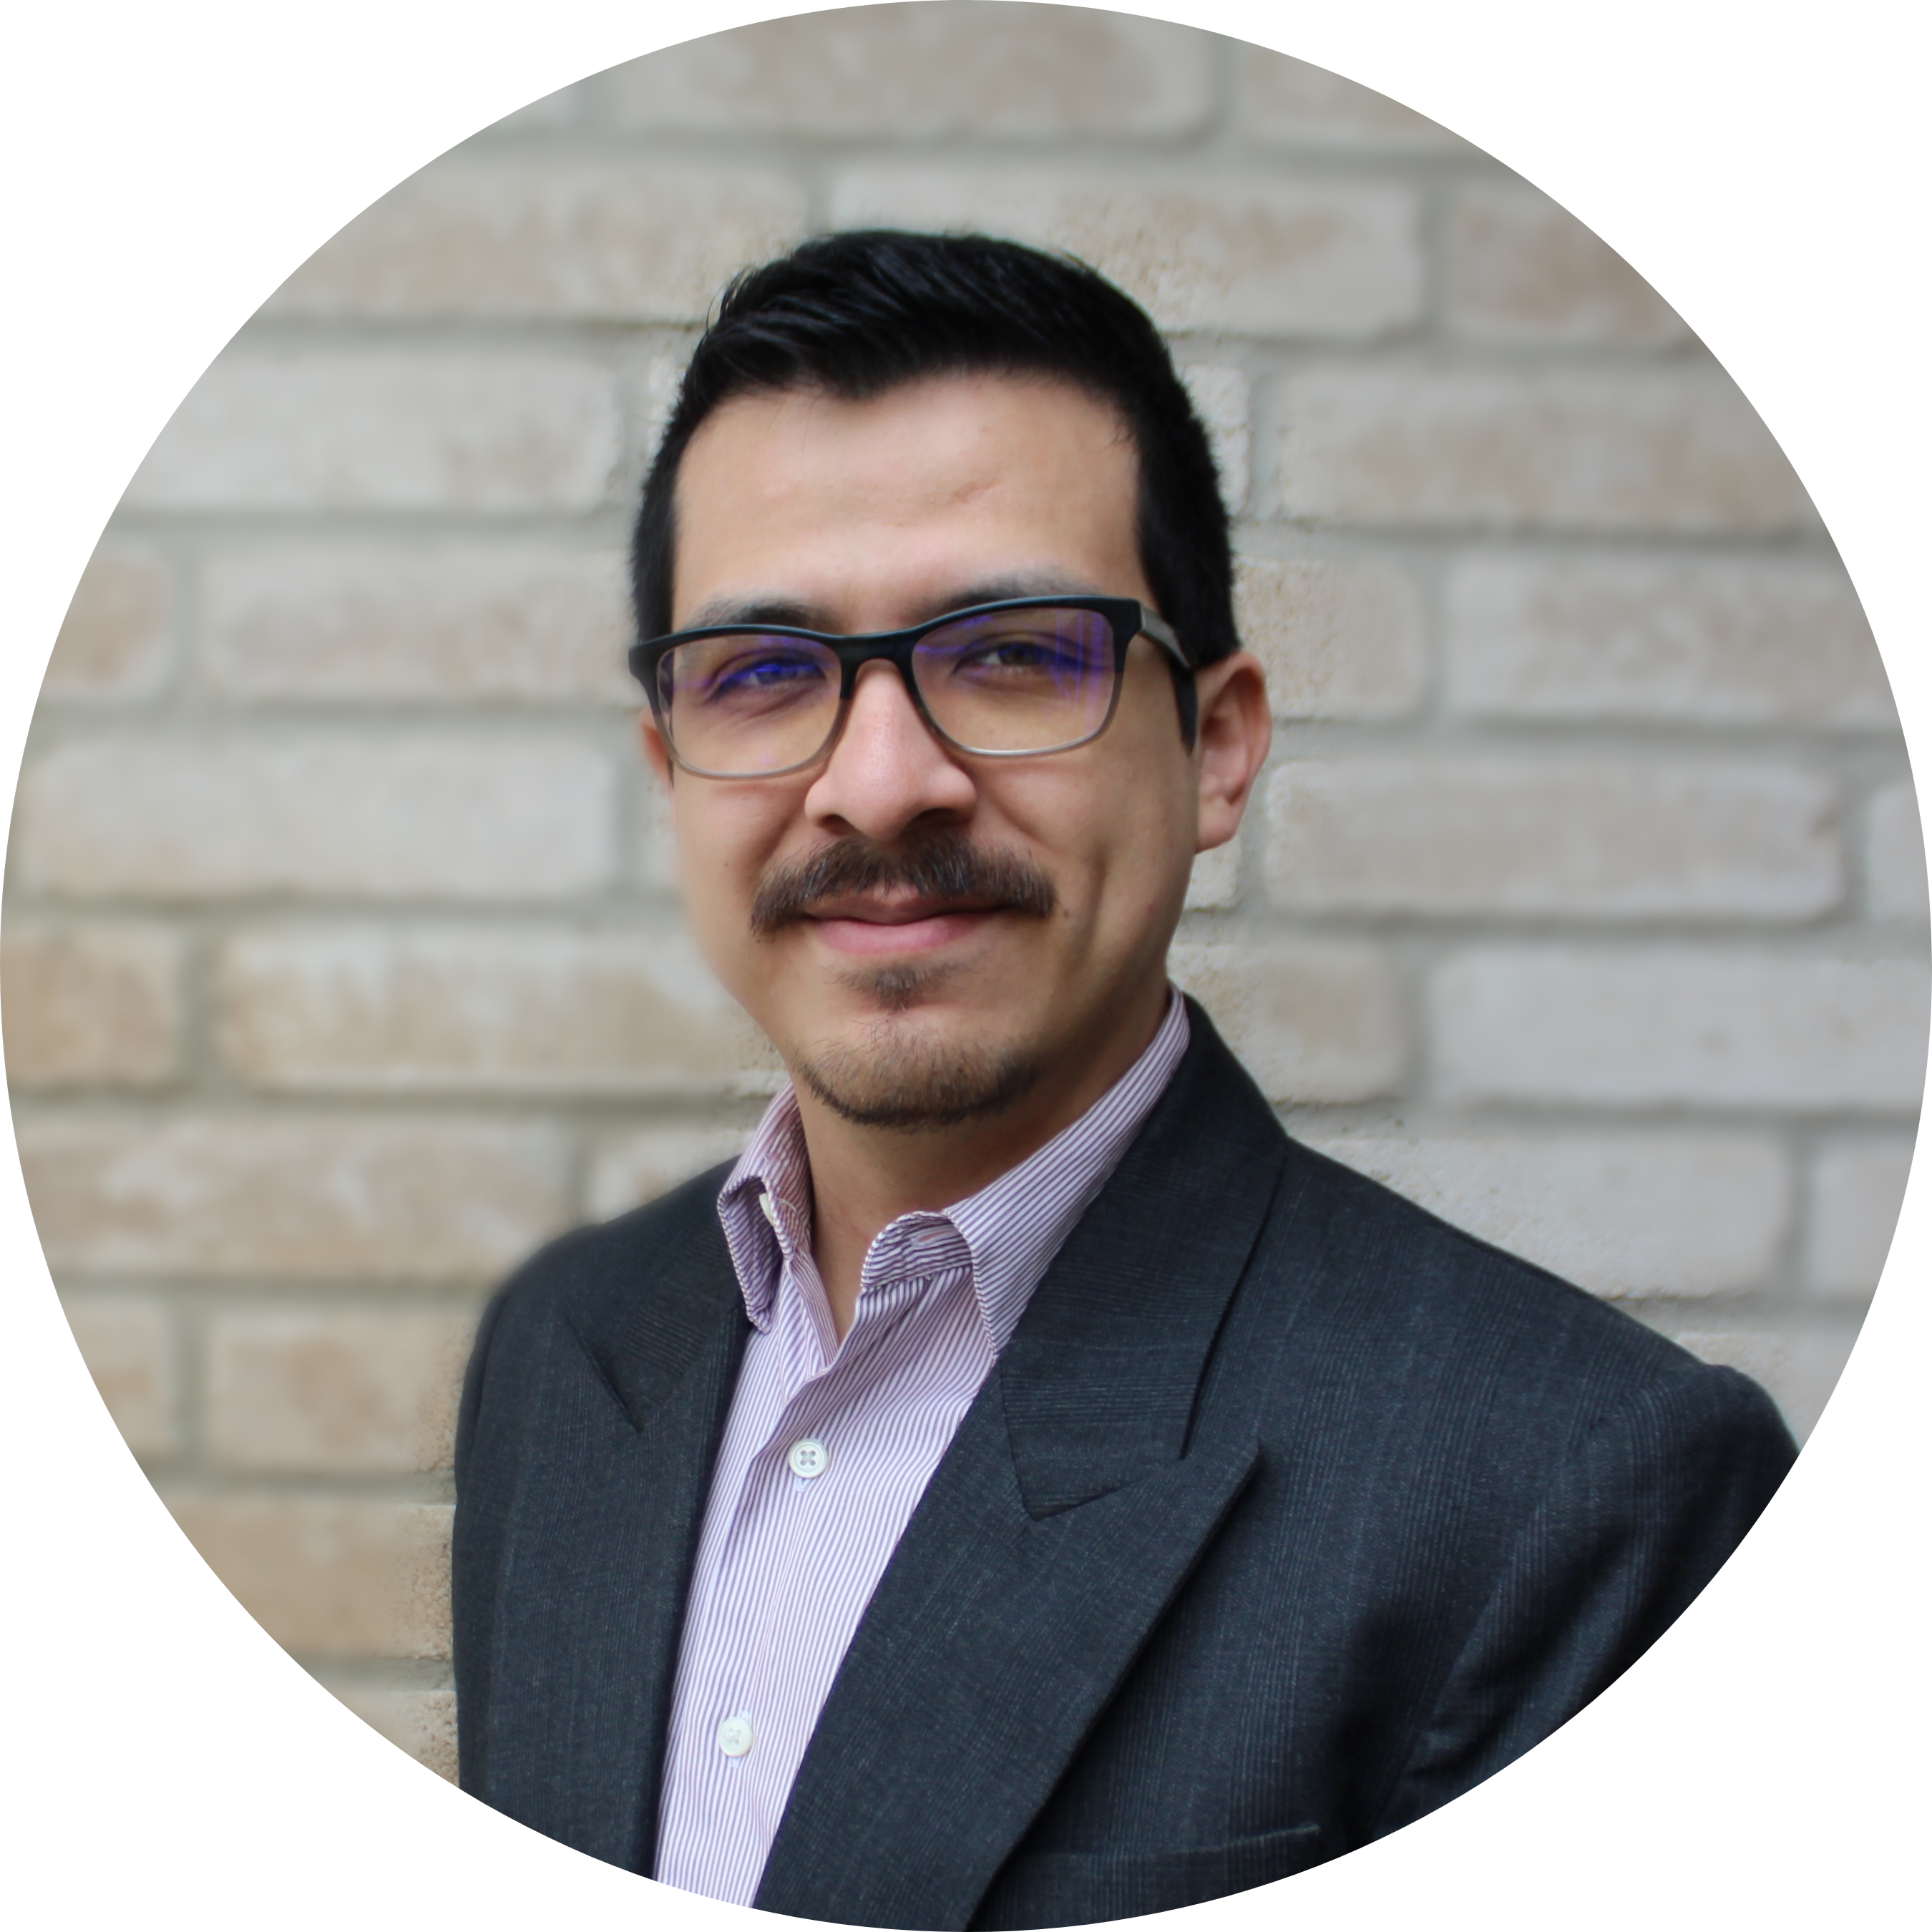
Javier Castro Sr. Consultant
Cloud & Product
Email
javier.castro@thebridge.com
Location
DFW, Texas
Mobile
(214) 374-9439
EXPERIENCE
Javier joined The Bridge in February 2024. He has previously worked in software consulting where he has worked in a wide variety of projects designing and implementing software solutions for clients mostly in the agriculture industry.
Industry Experience
Design | Development | CI/CD | Testing | SQL/NoSQL | Kubernetes | Azure | AWS | GitLab/Hub | Terraform
Microsoft Marketplace Offerings | Agriculture – B2B
Assisted with the design and development of 4 Java services that provided agriculture insights and weather data to B2B customers through Microsoft’s Marketplace.
Assisted in several areas of the project:
Acted as a cloud engineer helping define and provision the infrastructure for the services in Azure. Services used include AKS, Service Bus, Key Vault, PostgreSQL Flexible Server, App Service, APIM, ACR, Storage Account, among others.
Helped set up the CI/CD pipelines to ensure high confidence in new releases and resiliency/predictability between both infrastructure and service deployments.
Helped design and set up a secure, fault tolerant, scalable and robust Kubernetes architecture to be used for the starting marketplace offerings as well as future ones.
Contributed to the design and development of the marketplace offers as well as 3 supplementary services using Java, Spring and Hibernate.
Data Query Micro-services | Agriculture
Helped design and develop 4 new Scala micro-services for executing queries on substantial agricultural datasets and the processing, filtering, storing/caching, and displaying of results in a manner that satisfied customers growing needs.
The micro-services were RESTful APIs following an orchestrator pattern to ensure scalability. In addition, contributed to the development of 3 Java libraries used to interact with supporting micro-services in a standardized manner.
In addition to the development, also contributed to the set up of the CI/CD pipelines, provisioning of infrastructure in AWS, documentation of design and architecture, and planning portion of the project.
BACKGROUND
Functional Skills
Software Design, Software Implementation, Software Documentation, Backend Engineering, Frontend Engineering, Cloud Engineering, DevOps Engineering
Qualifications
Software Engineer with years of industry experience, strong technical proficiency and a deep drive for knowledge and solving complex technical challenges. Proven experience working with both sides of the stack, two of the major cloud providers, and other areas of the software development life cycle such as planning (SAFe), designing, testing, CI/CD, and maintenance.

Slide 2

Email
javier.castro@thebridge.com
Location
DFW, Texas
Mobile
(214) 374-9439
Javier joined The Bridge in February 2024. He has previously worked in software consulting where he has worked in a wide variety of projects designing and implementing software solutions for clients mostly in the agriculture industry.
Javier Castro
Sr. Consultant
Cloud & Product

Slide 3
Javier Castro Sr. Consultant — Cloud & Product
Email
javier.castro@thebridge.com
Mobile
(214) 374-9439
Location
DFW, Texas
BACKGROUND
EXPERIENCE
Functional Skills
Software Design, Software Implementation, Software Documentation, Backend Engineering, Frontend Engineering, Cloud Engineering, DevOps Engineering
Qualifications
Software Engineer with years of industry experience, strong technical proficiency and a deep drive for knowledge and solving complex technical challenges. Proven experience working with both sides of the stack, two of the major cloud providers, and other areas of the software development life cycle such as planning (SAFe), designing, testing, CI/CD, and maintenance.
Industry Experience
Design | Development | CI/CD | Testing | SQL/NoSQL | Kubernetes | Azure | AWS | GitLab/Hub | Terraform
Microsoft Marketplace Offerings | Agriculture – B2B
Assisted with the design and development of 4 Java ervices that provided agriculture insights and weather data to B2B customers through Microsoft’s Marketplace.
Assisted in several areas of the project:
Acted as a cloud engineer helping define and provision the infrastructure for the services in Azure. Services used include AKS, Service Bus, Key Vault, PostgreSQL Flexible Server, App Service, APIM, ACR, Storage Account, among others.
Helped set up the CI/CD pipelines to ensure high confidence in new releases and resiliency/predictability between both infrastructure and service deployments.
Helped design and set up a secure, fault tolerant, scalable and robust Kubernetes architecture to be used for the starting marketplace offerings as well as future ones.
Contributed to the design and development of the marketplace offers as well as 3 supplementary services using Java, Spring and Hibernate.
Data Query Micro-services | Agriculture
Helped design and develop 4 new Scala micro-services for executing queries on substantial agricultural datasets and the processing, filtering, storing/caching, and displaying of results in a manner that satisfied customers growing needs.
The micro-services were RESTful APIs following an orchestrator pattern to ensure scalability. In addition, contributed to the development of 3 Java libraries used to interact with supporting micro-services in a standardized manner.
In addition to the development, also contributed to the set up of the CI/CD pipelines, provisioning of infrastructure in AWS, documentation of design and architecture, and planning portion of the project.

